Slide 1

Brooks Burwell
Charis Hadi
Jon Hadi
Nick Meyers
910

Slide 2
910
The What
The Why
The Who

Slide 3


910
9
out of
10
said they would recycle if it was easier.

Slide 4
35% of Americans recycle.
910

Slide 5
When 75% of Americans recycle, it will be the equivalent of removing 55 million cars from U.S. roads each year.
910
Notes:
https://www.recycleacrossamerica.org/quick-glance

Slide 6
910
9
Mission: Increase the rate of recycling globally by making it easier for households to recycle.
out of
10
said they would recycle if it was easier.

Slide 7
910
The How

Slide 8
910
Provide users with pertinent data that is easy to comprehend and informs their behaviors.
Accumulate and maintain a dataset of recycling information across geographies that is reliable and accurate.
Provide a platform to create or participate in local recycling and environment clean up activities.

Slide 9
Applied Technologies
910
Axios
Bootstrap
Express
Moment.js
React
Sequelize
mySQL
Node.js

Slide 10
910
The Now

Slide 11

910
Inform
Locate
Act

Slide 12
910
The Future

Slide 13










Inform
910
Fluorescent Bulbs
Batteries
Aluminum Cans
Ink Cartridges
Plastic Bottles
Electronics
Barcode Scanning
Glass Bottles
Paper
Photo Identification
V1
V2
V3

Slide 14

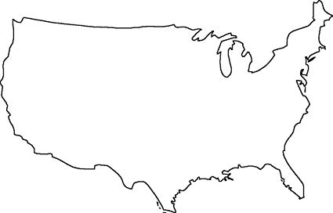

Locate
910
V1
V2
V3

Slide 15





Act
910
1
Sponsored Events
Attend
Push Notifications
Create
Calendar Sync
Competitions
V1
V2
V3

Slide 16
910
A Space In the “Market”

Slide 17

Shared Space – Recycle Across America
910
RAA focuses on standardization of recycling labels and bins.
Demographic focus is schools, businesses, and other organizations.
Geographic scope is America.

Slide 18
Shared Space – 910
910
910 helps users answer, “Can this be recycled?” and “How?”
Demographic focus is households.
Geographic scope is the entire, whole world.

Slide 19
Increase geographic footprint (Geo Value Stream)
Simplify How Do I feature (How Value Stream)

Slide 20
V2
Expand map tool across the US, across recycle streams, and across recycling-facility types
V3
How/Where-To-Recycle using uploaded image / photo

Slide 23
Focuses on households

